Slide 1

65
Sixty Five years of professional excellence
Notes:
1
03/11/2011
Thiagarajar College of Engineering

Slide 2
Outcomes Education and Curriculum Design
Dr S.BASKAR, BOYSCAST Fellow
Dean (R&D)
Professor of Electrical & Electronics Engineering
Thiagarajar College of Engineering
Madurai

Slide 3
Session Outcomes
After the successful completion of the four sessions, participants will be able to:
Appreciate the role of OBE in improving quality of education
Explain the difference between OBE and traditional curriculum design
Appreciate the role of Blooms Taxonomy in improving quality of teaching and learning activities
Articulate course outcomes (COs) for the given course
Compute the CO attainment using direct and indirect assessment methods
Compute the PO attainment using direct and indirect assessment methods
Design a OBE curriculum for the given programme

Slide 4
Contents
Traditional Curriculum Design
Traditional Education
Outcome Based Education (OBE)
PEO, GAs, POs, COs,Programme specific criteria
Blooms Taxonomy
Writing Course Outcomes
CO-PO Mapping
OBE based Curriculum Design

Slide 5
Traditional Curriculum design
Mostly Based on previous curriculum
Incremental changes –mostly addition/deletion of topics, change of books etc.,, removal of certain courses, introduction of new courses etc.,
Accumulation of courses /credits
Text book centered or Faculty centric or facilities available
To much focus on Contents

Slide 6
Traditional Curriculum Design- Problems
Depth is not clearly defined
Not a holistic approach
No Comprehensive assessment
Common Assessment pattern for all courses
Subjectivity in selection of delivery methods
No credits for Cocurricular and extra curricular activities
More weight for Knowledge domain ( less :Affective and Psychomotor domains)
More Content

Slide 7
Regulations
Academic law
Eligibility for admission
Minimum credits for the award of degree
Course categories
Internal and external assessment weightage
Credit allocation
Curricular components wise credit allocation
Attendance requirements
Period of study
Malpractice
Minimum working days
CBCS

Slide 8
Traditional Education
Provides students with a learning environment with little
attention to whether or not students ever learn the material.
Students are given grades and rankings compared to
each other – students become exam oriented or CGPA driven.
Graduates are not completely prepared for the workforce.
Lack of emphasis on soft skills needed in jobs e.g. communication skills, interpersonal skills, analytical skills, working attitude etc

Slide 9
Outcome Based Education (OBE)
Starting with a clear picture of what is important for students to be able to do…
Then organizing the curriculum, delivery and assessment to make sure learning happens…

Slide 10
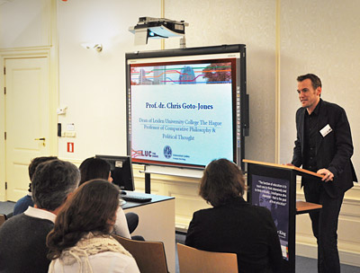


Course, Degree, Programme
Course
  Course is a unit of teaching, which encompasses various topics, that typically lasts one semester, is led by one or more faculty and has a fixed registered students.
Programme
  Cohesive arrangement of courses, co-curricular and extra-curricular activities to accomplish predetermined objectives leading to the awarding of a degree.
Degree
  Academic award conferred upon a student on successful completion of a program designed to achieve the defined attributes

Slide 11
Outcome Based Education (OBE)
What students will be able to do by the time and after few years of graduation?
‘Learner Centric’, rather than the traditional ‘Teacher Centric’
Continuous improvement in the educational (Teaching-Learning) process
Preparing Graduates to fit themselves globally
Effective and innovative Content delivery methods, assessment methods and procedures
Enrichment of Faculty involvement in the Teaching-Learning Process

Slide 12
Why OBE
International recognition and Global employment opportunities
More employable and innovative graduates with professional and soft skills, social responsibility and ethics
Better visibility and reputation of technical institution among stakeholders
Improving the commitment and involvement of all stakeholders
Enabling graduates to excel in their profession and career accomplishments
Preparing graduates with leadership positions and challenging technology development opportunities

Slide 13
Traditional Education
financial resources
Programme
lab equipment
Number of students graduating
Infrastructure facilities
quantitative grades of students
faculties
Number of students placed
Number of students
Measureable Input
Measurable Outputs

Slide 14
Outcome Based Education
Measureable Inputs
financial resources
Programme
Course outcomes
lab equipment
Knowledge, skills and behaviour of students graduating
Infrastructure facilities
faculties
career and professional accomplishments of graduates
Number of students
Measurable Outcomes

Slide 15
Input-Output-Outcomes
Input - infra, students, financial resources, faculty …
Output- Average CGPA, Number of students graduated, number of students placed , …
Outcomes – accomplishment of output
Course outcomes (COs), Programme
outcomes (POs), Professional outcomes
(or) PEOs
Some examples of outcomes

Slide 16
OBE Principles
Clarity of focus
  Facilitate student achievements on the intended learning outcome
  Clarify short and long term learning intentions
  Assist learners to attain outcomes
  Focus assessment on outcomes
Expanded opportunities
  Provide multiple opportunities to match different learner’s needs
High expectations for all to succeed
  Most student achieve high standards if they are given appropriate opportunities
Designing Backward
  Curriculum design begin with exit outcomes, followed by building block of learning

Slide 17
Benefits of OBE -Teacher
Teaching will become a far more creative and innovative career.
Lecturers will no longer feel the pressure of having to be the “source of all knowledge”
Producing thinking, caring students.
The role of the faculty adapts into instructor, trainer, facilitator, and/or mentor based on the outcomes targeted

Slide 18
Benefits of OBE -Teacher
Teaching will become a far more creative and innovative career.
Lecturers will no longer feel the pressure of having to be the “source of all knowledge”
Producing thinking, caring students.

Slide 19
Keys of OBE System
(William G. Spady)
Developing a clear set of learning outcomes around which all of the system's components can be focused
Establishing the conditions and opportunities within the system that enable and encourage all students to achieve those essential outcomes
Having learners do important things with what they know is a major step beyond knowing itself

Slide 20
OBE -5 D’s
Define Outcomes
Design Curriculum
Deliver Instruction
Document Results
Determine Advancement

Slide 21
OBE Assumptions
all learners can learn and succeed;
success breeds success; and
“teaching institutions” control the conditions of success.

Slide 22
Key Components of OBE
Vision and Mission of the Institute
Vision and Mission of the Department
Programme Educational Objectives (PEOs)
Graduate Attributes (GAs)
Programme Outcomes (POs)
Course Outcomes (COs)
Programme Specific Criteria

Slide 23
VISION AND MISSION OF THE INSTITUTION
Vision:
Vision is a picture of the future you seek to create, described in the present tense, as if it were happening now. It shows where we want to go, and what we will be like when we get there.
Mission:
Mission statement defines what an institution is, why the institution exists, its reason for being. It defines what are we here to do together

Slide 24
Department - VISION AND MISSION
The vision and mission of the department should be correlated with the mission and vision of the institution.
more focused on the theme area and based on the SWOT analysis.
A mission statement might include a brief history and philosophy of the academic programme, the type of students to be served, the academic environment and primary focus of the curriculum, faculty roles, the contributions to and connections with the community, the role of research.

Slide 25
Programme Educational Objectives (PEOs)
PEOs are broad statements that describe the career and professional accomplishments that the programme is preparing graduates to accomplish after 3 to 5 years of graduation.
PEOs should be measurable, appropriate, realistic, and achievable.
PEOs addresses needs of the stakeholders

Slide 26
Program Educational objectives (PEOs) –An Example
Successful Careers (PEO#1): Graduates of the programme will have successful technical or professional careers.
Lifelong Learning (PEO#2): Graduates of the programme will continue to learn and to adapt in a world of constantly evolving technology.
26

Slide 27
PEOs
  Develop assessment methods for each PEO to measure the attainment with expected attainment level for each PEO
  generally a good idea to identify between three and five PEOs.
  Publish and Disseminate the PEOs among the stakeholders.
  Check for the consistency of the PEOs with the mission statements of the Department.

Slide 28
Graduate Attributes (GAs)
A set of individually assessable outcomes that are the components indicative of the graduate’s potential to acquire competence to practice at the appropriate level.
The GAs are exemplars of the attributes expected of a graduate from an accredited programme.
International Engineering Alliance – IEA
Washington Accord (UG-Engg), Sydney Accord (Diploma) , Dublin Accord (ITI)
Seoul Accord -Computer professionals

Slide 29

Summary of Graduate Attributes
Engineering knowledge
Problem analysis
Design & Development of Solutions
Investigation of Complex Problem
Modern tool usage
Engineer and society
Environment& sustainability
Ethics
Individual & team work
Communication
Lifelong learning
+ Project management & finance
29

Slide 30
IEA-Graduate Attributes Ver-3.0
Engineering knowledge: Apply the knowledge of mathematics, science, engineering fundamentals, and an engineering specialisation to the solution of complex engineering problems.
Problem analysis: Identify, formulate, research literature, and analyse complex engineering problems reaching substantiated conclusions using first principles of mathematics, natural sciences, and engineering sciences.
Design/development of solutions: Design solutions for complex engineering problems and design system components or processes that meet the specified needs with appropriate consideration for the public health and safety, and the cultural, societal, and environmental considerations.
Conduct investigations of complex problems using research-based knowledge and research methods including design of experiments, analysis and interpretation of data, and synthesis of the information to provide valid conclusions.

Slide 31
IEA-Graduate Attributes Ver-3.0
Modern tool usage: Create, select, and apply appropriate techniques, resources, and modern engineering and IT tools including prediction and modeling to complex engineering activities with an understanding of the limitations.
The engineer and society: Apply reasoning informed by the contextual knowledge to assess societal, health, safety, legal, and cultural issues and the consequent responsibilities relevant to the professional engineering practice.
Environment and sustainability: Understand the impact of the professional engineering solutions in societal and environmental contexts, and demonstrate the knowledge of, and need for the sustainable development.
Ethics: Apply ethical principles and commit to professional ethics and responsibilities and norms of the engineering practice.
Individual and team work: Function effectively as an individual, and as a member or leader in diverse teams and in multidisciplinary settings.

Slide 32
IEA-Graduate Attributes Ver-3.0
Communication: Communicate effectively on complex engineering activities with the engineering community and with society at large, such as, being able to comprehend and write effective reports and design documentation, make effective presentations, and give and receive clear instructions.
Project management and finance: Demonstrate knowledge and understanding of the engineering and management principles and apply these to one’s own work, as a member and leader in a team, to manage projects and in multidisciplinary environments.
Life-long learning: Recognise the need for, and have the preparation and ability to engage in independent and life-long learning in the broadest context of technological change.

Slide 33
Programme Outcomes (POs)
POs describe what students should know and be able to do at the end of the programme.
POs are to be in line with the graduate attributes of IEA.
POs are to be specific, measurable and achievable.
POs transform the PEOs into specific student performance and behaviors that demonstrate student learning and skill development

Slide 34
Programme Outcomes -Guidelines
Describe student performance, not teacher/professor performance
Describe learning product, not process
Are specific without simply stating the subject matter to be learned
Stick to one type of result for each outcome (e.g., do not say “Knows the scientific method and applies it effectively”)
Start with an action verb that indicates observable and measurable behavior

Slide 35
Programme Outcomes –Contd.
Develop assessment methods for each PO to measure the attainment.
Publish and Disseminate the POs among the students and faculty.
Check for the consistency of the POs with the PEOs of the Programme and Graduate Attributes.

Slide 36
PROGRAMME SPECIFIC CRITERIA (PSC)
Each programme must satisfy a set of criteria specific to it, known as Programme Specific Criteria which deal with the requirements for engineering practice particular to the related sub-discipline.
concern about curricular issues and qualifications of faculty.
The programme curriculum is to be provided in correlation with the programme specific criteria.
NBA adopts PSC specified by appropriate American Professional societies such as ASME, ASCE, IEEE etc.
The institution shall provide evidence that the programme curriculum satisfies the PSC , and industry specific criteria and industry interactions/internship.

Slide 37
PROGRAMME SPECIFIC CRITERIA
Program Criteria for Civil and Similarly Named Engineering Programs
Lead Society: American Society of Civil Engineers (ASCE)
These program criteria apply to engineering programs including "civil" and similar modifiers in their titles.
1. Curriculum
The program must prepare graduates to apply knowledge of mathematics through differential equations, calculus-based physics, chemistry, and at least one additional area of basic science, consistent with the program educational objectives; apply knowledge of four technical areas appropriate to civil engineering; conduct civil engineering experiments and analyze and interpret the resulting data; design a system, component, or process in more than one civil engineering context; explain basic concepts in management, business, public policy, and leadership; and explain the importance of professional licensure.

Slide 38
PROGRAMME SPECIFIC CRITERIA
Program Criteria for Computer Science and Similarly Named Computing Programs
Lead Society: Institute of Electrical and Electronics Engineers (IEEE) Cooperating Society for Computer Engineering Programs: CSAB
These program criteria apply to computing programs using computer science or similar terms in their titles. The program must enable students to attain, by the time of graduation:
An ability to apply mathematical foundations, algorithmic principles, and computer science theory in the modeling and design of computer-based systems in a way that demonstrates comprehension of the tradeoffs involved in design choices.
An ability to apply design and development principles in the construction of software systems of varying complexity.

Slide 39
Course Outcomes
The course outcomes must state the major skills, knowledge, attitude or ability that students will acquire.
Course outcomes should be expressed in terms of measurable and/or observable behaviors
Course Outcomes should be agreed upon by the faculty in a program and should drive program outcomes.
Course outcomes should begin with an action verb (e.g., write, install, solve, and apply).

Slide 40
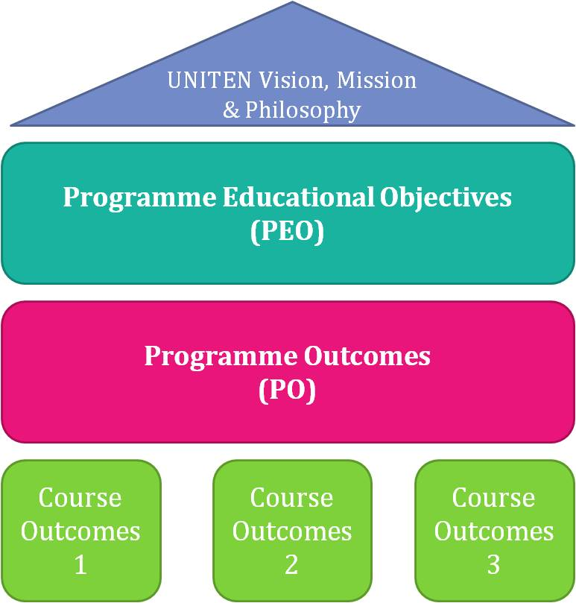
OBE Design
design
Vision
Mission
Graduate
Attributes

Slide 41
Mapping between PEOs,POs and COs
COs
♦
GAs
♦
♦
♦
*
POs
*
*
+
.
*
+
+
.
.
Mission
*
*
.
+
*
+
+
*
*
+
PEOs
*

Slide 42
Content delivery
Lecture
Lecture with discussion
Demonstrations
Group discussion
Debate
Technical Quiz
Seminar
Mini-project
Asynchronous discussions

Slide 43
Assessment Tools
Direct methods display the student’s knowledge and skills from their performance in the continuous assessment tests, end-semester examinations, presentations, and classroom assignments etc.
These methods provide a sampling of what students know and/or can do and provide strong evidence of student learning.

Slide 44
Assessment Tools
Indirect methods such as surveys and interviews ask the stakeholders to reflect on student’s learning.
They assess opinions or thoughts about the graduate’s knowledge or skills.
Indirect measures can provide information about graduate’s perception of their learning and how this learning is valued by different constituencies.

Slide 45
Assessment methods and tools
Direct Assessment Method: using measurable performance indicators of students
  Exams
  Assignments
  Projects
  Tutorials
  Labs
  Presentations
Indirect Assessment Method: Ascertaining opinion or self-reports
  Alumni survey
  Employer survey
  Exit survey
  Course-end survey, etc.,.
45

Slide 46
Rubrics
Rubrics is set of performance indicators which define and describe the important component of the work being completed
Information to/about individual student competence (Analytic)
  Communicate expectations
  Diagnosis for purpose of improvement and feedback
Overall examination of the status of the performance of a group of students? (Holistic)
46

Slide 47
Generic or Task Specific ?
47
Generic
  General rubric that can be used across similar performance (used across all communication task or problem solving tasks)
  Big picture approach
  Element of subjectivity
Task specific
  Can only be used for a single task
  Focused approach
  Less subjective

Slide 48


When to Assess
Program Educational Objectives(PEOs)
Few years after
Graduation – 4 to 5 years
Program Outcomes (POs)
Upon
graduation
Course Outcomes (COs)
Upon
course completion
Notes:
48
48

Slide 49
PEO Assessment tools
The data may be collected progressively
Survey questions should elicit the required information
  Not to confirm the objective
Ex. PEO: producing the graduates with leadership qualities
  Employer survey
  Q1: At which level/position our graduates (year) are working in your organization
Assessment Tool (frequency)
Employer satisfaction survey (Yearly) Alumni survey (Yearly). Placement records, higher education records
49

Slide 50
Outline
Present scenario in Engineering Education
Importance of assessment
Classification of Assessment methods
Blooms Taxonomy –Cognitive, Psychomotor, Affective
Two-step mapping process
Assessment planning -Recommendations
Assessment Tools HOTs
Open book examinations
Rubrics

Slide 51
AICTE ERP
In Section-1, the most important drivers for examination reforms in Indian engineering education system are discussed.
Section-2 brings out strategies to be adopted to align assessment with the desired student learning outcomes.
A two-step method is proposed for mapping the examination questions with course outcomes.

Slide 52
AICTE-ERP
Section-3 highlights the necessity of designing question papers to test higher order abilities and skills.
Application of blooms taxonomy framework to create an optimal structure of examination papers to test the different cognitive skills is discussed in detail.
Challenge of assessing higher order abilities and professional skills through traditional examination system is brought out in Section-4.
Several educational experiences and assessment opportunities are identified to overcome the challenges
Appendices contain the supplement material that is helpful for Universities/ Colleges to implement recommendations.

Slide 53
Assessment
Assessment drives learning
What and how students learn depends on how they will be assessed
Simple memory recall questions will not ensure deep meaningful learning
Quality of questions in Indian Engineering Education is matter of concern 80-90% questions in R and U
Report attempts to bring out recommendations for reforms in examination system to meet challenges of emerging engineering education landscape.
Not assessing HOTS and Professional skills

Slide 54
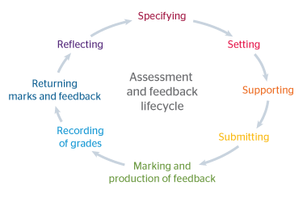
Various Assessment methods
Direct Vs Indirect
Summative Vs Formative
Controlled Vs uncontrolled
Role of rubrics in Assessment

Slide 55
Assessment methods and tools
Direct Assessment Method: using measurable performance indicators of students
  Exams
  Assignments
  Projects
  Tutorials
  Labs
  Presentations
Indirect Assessment Method: Ascertaining opinion or self-reports
  Alumni survey
  Employer survey
  Exit survey
  Course-end survey, etc.,.
55

Slide 56
Present examination system
Memorization occupies a dominant place.
Recall of factual knowledge, though essential to any examination, is only one of several major abilities to be demonstrated by the graduates
To test higher level skills viz. ability to apply knowledge, solve complex problems, analyze, synthesize and design.
Further, professional skills like the ability to communicate, work in teams, lifelong learning have become important elements for employability of the graduates .
To give appropriate weightage to the assessment of these higher-level skills and professional competencies.

Slide 57
Present CO-PO mapping
COs | PO1 | PO2 | PO3 | PO4 | PO5 | PO6 | PO7 | PO8 | PO9 | PO10 | PO11 | PO12 | PSO1 | PSO2
CO1 | S | M | L | L | S | M |  | M | M | M |  |  |  | S
CO2 | S | S | M | M | S | M |  | M | M | M |  |  |  | S
CO3 | S | S | M | M | S | M |  | M | M | M |  |  |  | S
CO4 | S | S | M | M | S | M |  | M | M | M |  |  |  | S
CO5 | S | S | M | M | S | M |  | M | M | M |  |  |  | S
CO6 | S | S | M | M | S | M |  | M | M | M |  |  |  | S
CO7 | S | S | S | S | S | M |  | M | M | M |  |  |  | S

Slide 58
Mapping POs with Assessment
POs represent fairly high-level generic goals that are not directly measurable.
Different abilities implied by POs that requires multiple assessment measures
Real observability and measurability of the POs at course level is very difficult, therefore two-step process is proposed
POs-Competencies-Performance Indicator-Assessment
Engineering Graduate Attribute Development (EGAD) Project - Reference

Slide 59
Two step mapping process
POs reflect the skills, knowledge and abilities of graduates regardless of the field of study
In OBE, a “design down” process is employed which moves from POs to COs
Courses are the building blocks of a program.
Teaching strategies, learning activities, assessments and resources should all be designed and organized to help students achieve the learning outcomes at the course level.
In the assessment activities, students demonstrate their level of achievement of the course learning outcomes.

Slide 60
Competencies To be attained (CA)
Identify Competencies to be attained
For each PO define competencies –different abilities implied by PO statement
Generally require different assessment methods
Helps us to create a shared understanding of the competencies we want students to achieve.
Serve as an intermediate step to the creation of measurable indicators.

Slide 61
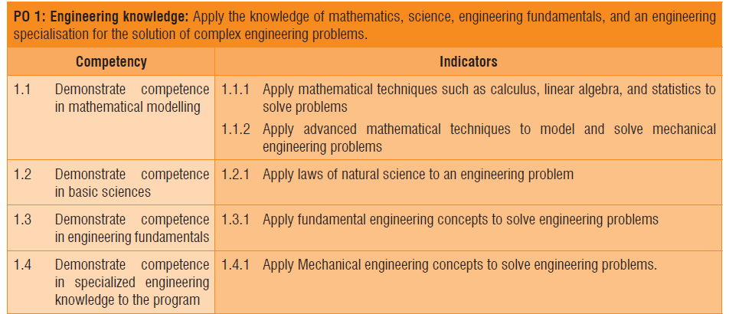

Slide 62
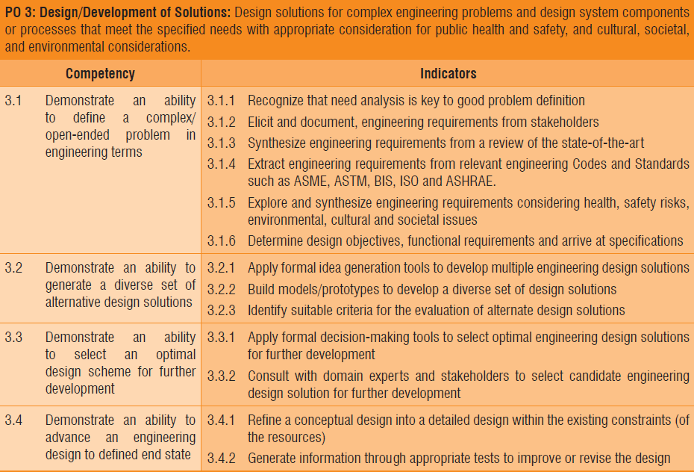

Slide 63
Performance Indicator (PIs)
For each of the competencies identified, define performance Indicators (PIs) that are explicit statements of expectations of the student learning.
They can act as measuring tools in assessment to understand the extent of attainment of outcomes.
They can also be designed to determine the appropriate achievement level or competency of each indicator so that instructors can target and students can achieve the acceptable level of proficiency

Slide 64
PO–CA-PI- Assesment
POs looks like, it can be achieved only in the Capstone project.
After considering the competencies and performance indicators, we start seeing the opportunities of addressing them (and hence PO) in various courses of the program.
Once the above process is completed for the program, the assessment of COs for all the courses is designed by connecting assessment questions (used in various assessment tools) to the PIs.
By following this process, where examination questions map with PIs, we get clarity and better resolution for the assessment of COs and POs. The pictorial representation of the process is given in Fig. 1

Slide 65
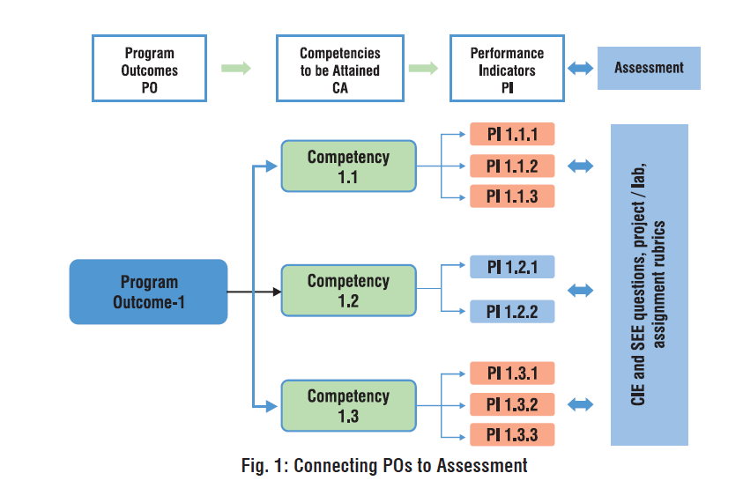
POs and Assessment

Slide 66
Assessment Planning -1
Normally the first three learning levels; remembering, understanding and applying and to some extent fourth level analyzing are assessed in the Continuous Internal Evaluation (CIE) and Semester End Examinations (SEE), where students are given a limited amount of time.
Abilities of analysis, evaluation and creation can be assessed in extended course works or in a variety of student works like course projects, mini/ minor projects, internship experience and final year projects

Slide 67
Assessment Planning -2
Before adopting this framework for reforms in examination system of a University/Institution, it is worthwhile to study the present pattern of assessment in each of the course in the program to gain insight about:
  a) Alignment of assessment questions with course learning outcomes
  b) Whether all the learning outcomes are tested; sometimes some learning outcomes are over tested at the expense of others which may be not tested at all.
  c) Overall weightage in the assessment, to each of Bloom’s learning levels
  d) Assessment methods used to adequately assess the content and desired learning outcomes

Slide 68
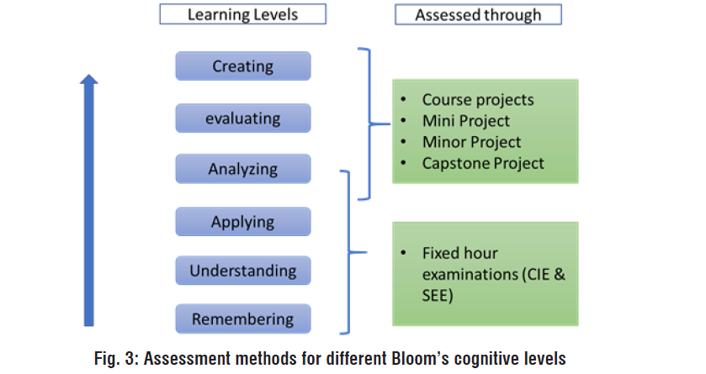
Assessment methods and KL

Slide 69
Assessment Planning -3
A good and reasonable examination paper must consist of various difficulty levels to accommodate the different capabilities of students.
Bloom’s taxonomy framework helps the faculty to set examination papers that are well balanced, testing the different cognitive skills without a tilt towards a tough or easy paper perception.
If the present examination questions are more focused towards lower cognitive skills, conscious efforts need to be made to bring in application skills or higher cognitive skills in the assessment.
It is recommended that at institution/ University level, upper limit need to be arrived for lower order skills (for example, no more than 40% weightage for knowledge-oriented questions).
It is important to note that, as nature of every course is different, the weightage for different cognitive levels in the question papers can also vary from course to course.

Slide 70
Rubrics
Rubrics is set of performance indicators which define and describe the important component of the work being completed
Information to/about individual student competence (Analytic)
  Communicate expectations
  Diagnosis for purpose of improvement and feedback
Overall examination of the status of the performance of a group of students? (Holistic)
70

Slide 71
Generic or Task Specific ?
71
Generic
  General rubric that can be used across similar performance (used across all communication task or problem solving tasks)
  Big picture approach
  Element of subjectivity
Task specific
  Can only be used for a single task
  Focused approach
  Less subjective

Slide 72
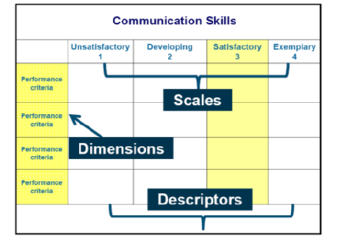

Slide 73
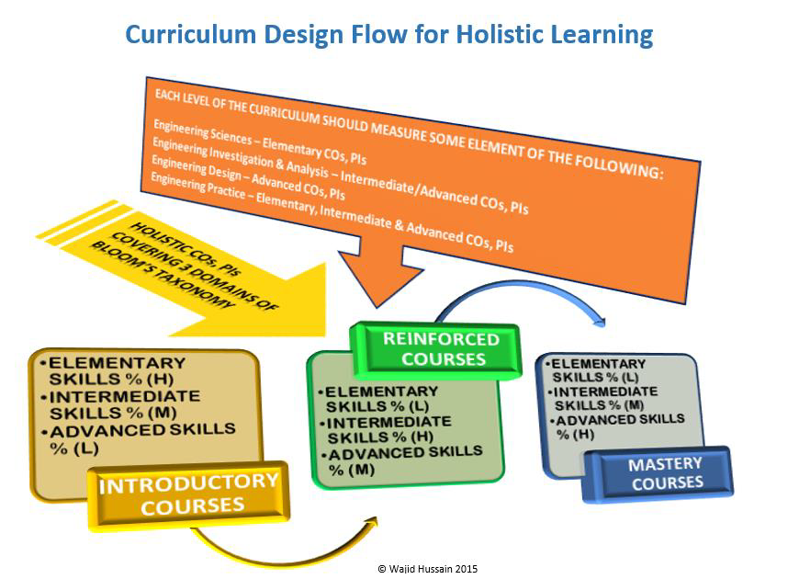

Slide 74
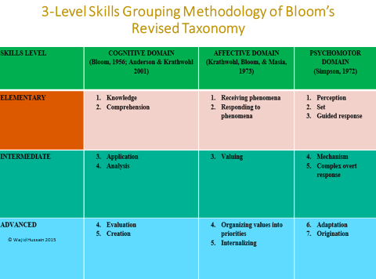

Slide 75
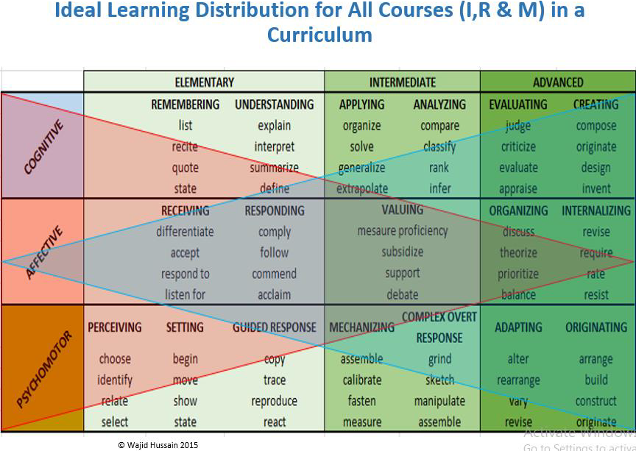

Slide 76
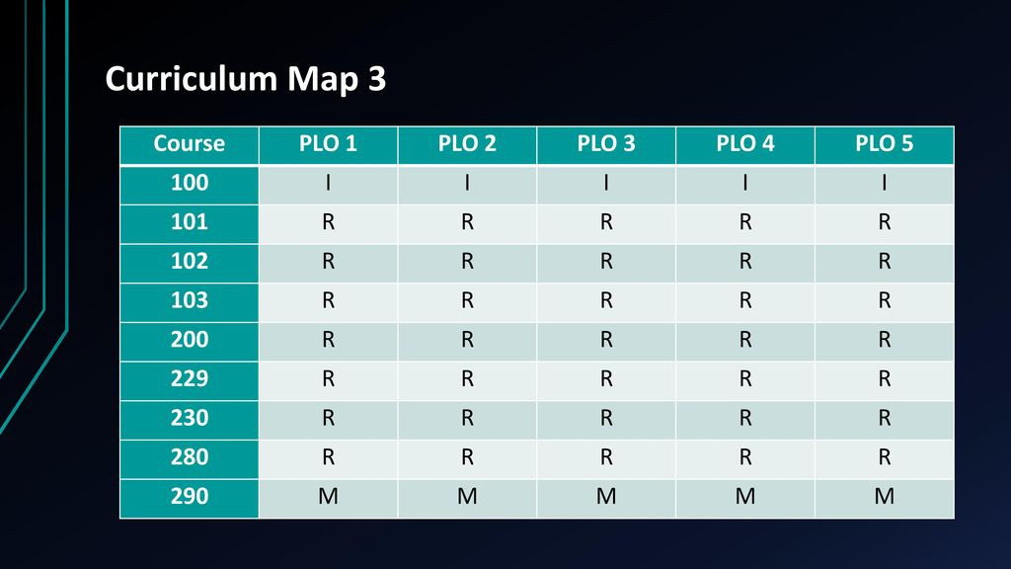

Slide 77
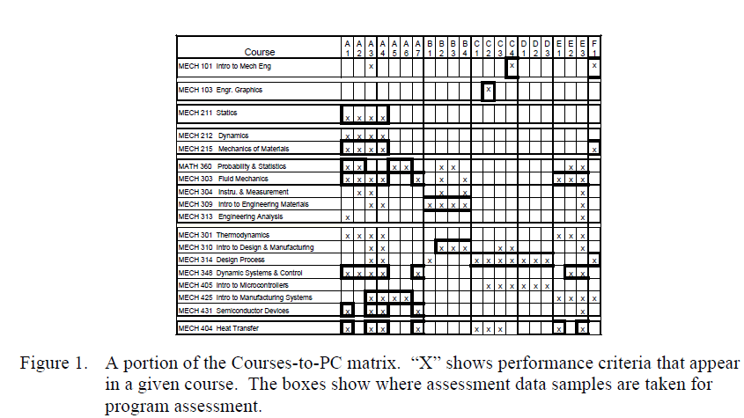

Slide 78
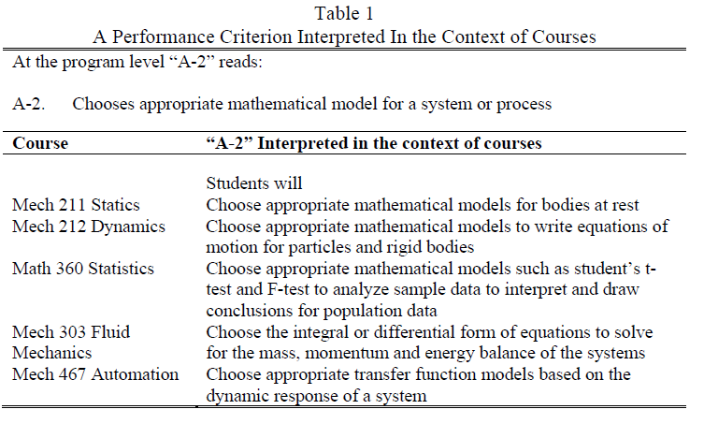

Slide 79
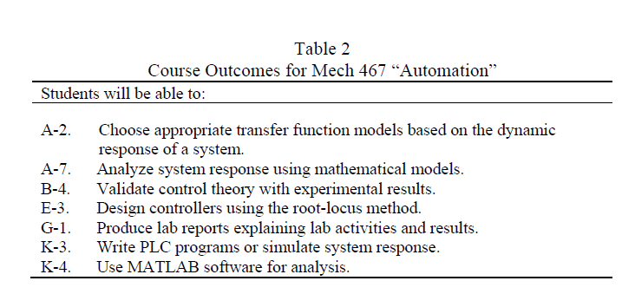

Slide 80
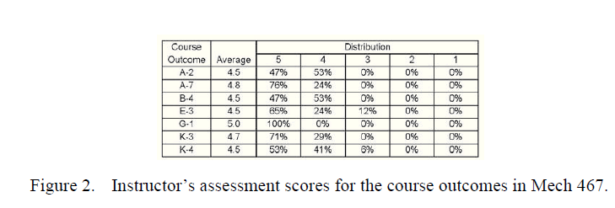

Slide 81
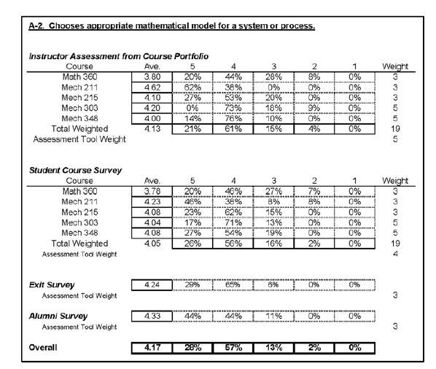

Slide 82
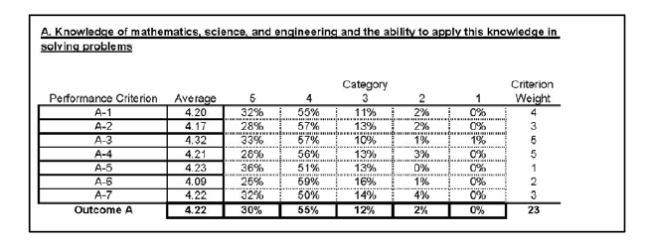

Slide 83
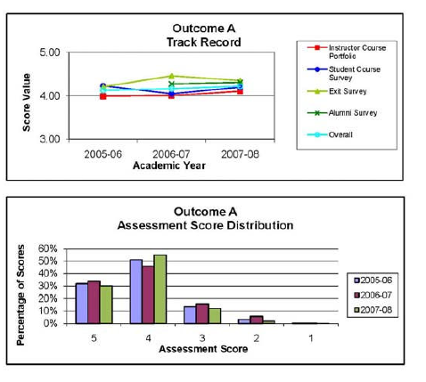

Slide 84
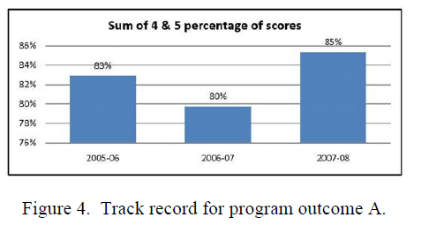

Slide 85
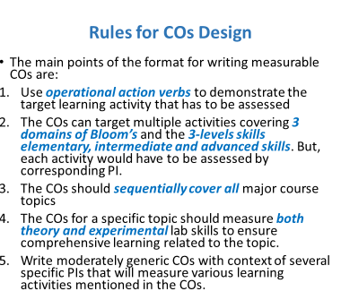

Slide 86


Slide 87
Thank you

